Slide 1
USRDS Project Xiaohan Cheng Apr 26th , 2022
Notes:
Second-year Master of Engineering in Financial Technology student

Slide 2
Project Purpose
USRDS dataset: The United States Renal Data System (USRDS) is a national data system that collects, analyzes, and distributes information about chronic kidney disease (CKD) and end-stage renal disease (ESRD) in the United States.
Results in 1,244,877 unique patients with 47,184,557 patient months of data.
1/1/2003 ⩽first service date ⩽12/31/2017
The goal is to predict 1-year mortality
Notes:
The first column is time to death, so if the time is missing it means the subject is alive.

Slide 3
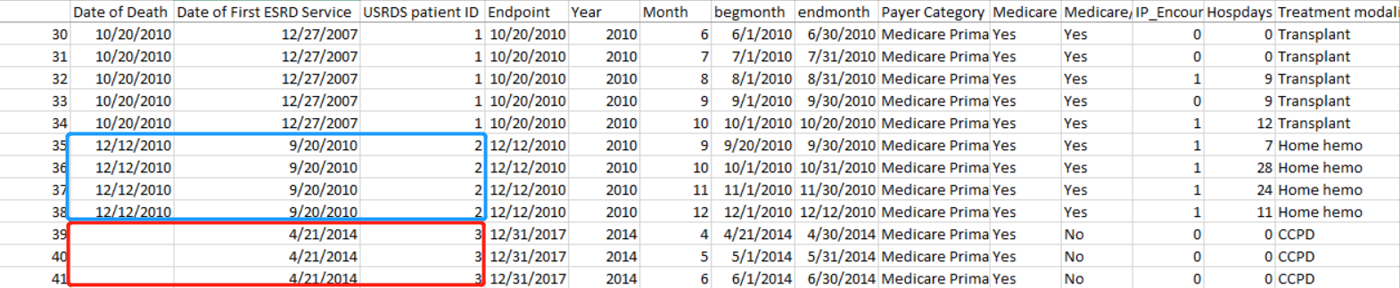
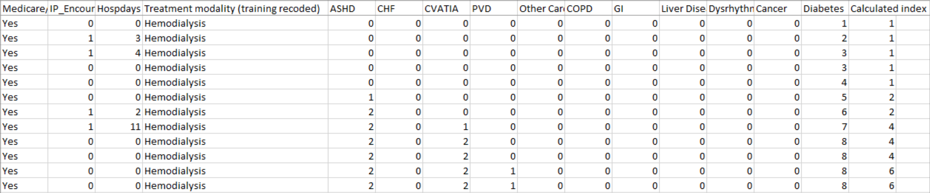
Data description
Notes:
The first column is time to death, so if the time is missing it means the patient is alive.
Each patient has an record every calendar month, starting with the month of their first service date until the death date of the end of the dataset.
The dataset has variables for different conditions in the index: ASHD, CHF, CVATIA, PVD, Other cardiac, COPD, GI, Liver disease, dysrhythmia, cancer, and diabetes. These condition specific variable are numbers, indicating the number of the months a condition has been observed. Any positive number indicates the condition contributes to the overall index score which is also saved in the dataset.

Slide 4
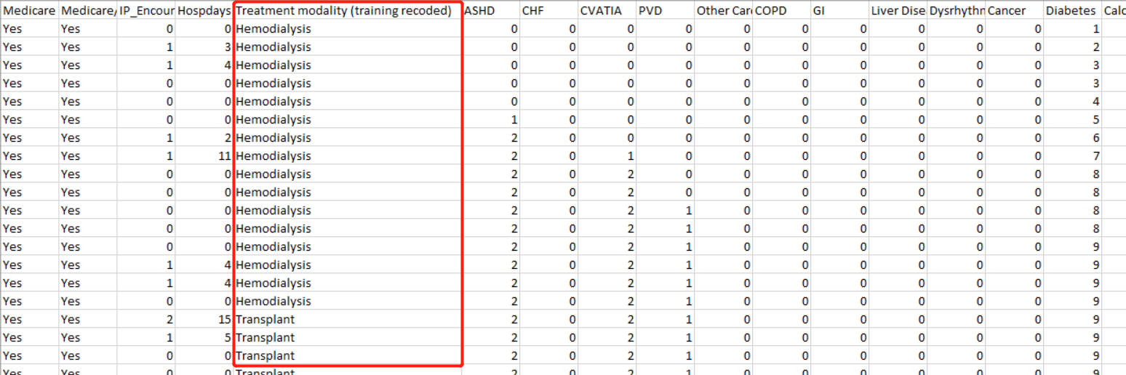
Data Preprocessing
The covariates are all the columns after the medicare plan, they should be either binary or ordinal
OneHot encodes Treatment modality (training recoded)
Use all records(rows) for one patient

Slide 5
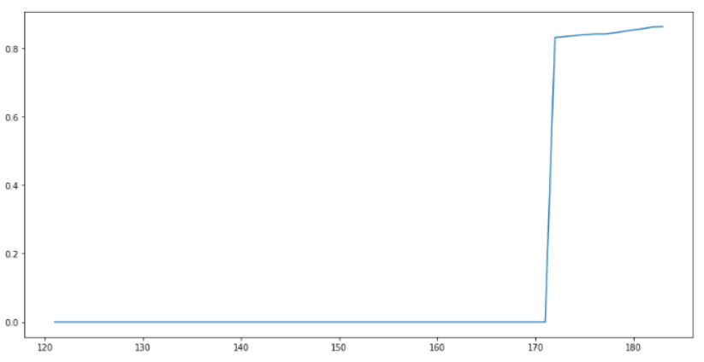
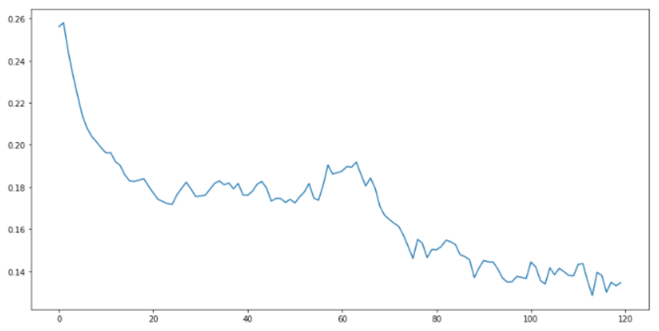
Data Preprocessing: Generate Labels
Align to the right.
Assuming everyone has last encounter.
Align to the left.
Assuming everyone has first encounter.
Time | 1 | 2 | 3 | 4 | 5 | 6 | 7
Patient 1 |  |  |  |  | Y | Y | Y
Patient 2 | Y | Y | Y | Y | Y | Y | Y
Patient 3 |  |  | Y | Y | Y | Y | Y
Time | 1 | 2 | 3 | 4 | 5 | 6 | 7
Patient 1 | Y | Y | Y
Patient 2 | Y | Y | Y | Y | Y | Y | Y
Patient 3 | Y | Y | Y | Y | Y
Notes:
There are more than 47 million rows. A suitable amount of data is around 0.3 million to 1 million.
it is time consuming and I‘m still working on a model with the full dataset.

Slide 6
Data Preprocessing: Padding and Masking
0 | 0 | 0 | 0 | 0 | 0 | 1
0 | 0 | 0 | 1 | 1 | 1 | 1 | 1 | 1 | 1
1 | 1 | 1 | 1
0 | 0 | 0 | 0 | 0 | 0
0 | 0 | 0 | 1 | 1 | 1
Padding
Masking
0 | 0 | 0 | 0 | 0 | 0 | 1 | -1 | -1 | -1
0 | 0 | 0 | 1 | 1 | 1 | 1 | 1 | 1 | 1
1 | 1 | 1 | 1 | -1 | -1 | -1 | -1 | -1 | -1
0 | 0 | 0 | 0 | 0 | 0 | -1 | -1 | -1 | -1
0 | 0 | 0 | 1 | 1 | 1 | -1 | -1 | -1 | -1
Notes:
Padding basically extends the dimension of the dataset.
Padding make all sequences in a batch fit a given standard length. it is necessary to pad some sequences.
Masking is a way to tell sequence-processing layers that certain timesteps in an input are missing, and thus should be skipped when processing the data.

Slide 7
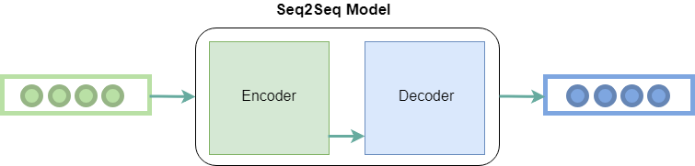
Model
Multi-label prediction
Seq2Seq Model with LSTM encoder and decoder
Seq2Seq Model with LSTM encoder and linear decoder

Slide 8
























Seq2Seq Model with LSTM encoder and decoder
$$y_{1}$$
$$y_{2}$$
$$y_{3}$$
$$y_{4}$$
$$(h_{1}^{2},c_{1}^{2})$$
$$(h_{2}^{2},c_{2}^{2})$$
$$(h_{3}^{2},c_{3}^{2})$$
$$(h_{4}^{2},c_{4}^{2})$$
$$(s_{1}^{2},c_{1}^{2})$$
$$(s_{2}^{2},c_{2}^{2})$$
$$(s_{3}^{2},c_{3}^{2})$$
$$(s_{4}^{2},c_{4}^{2})$$
$$(h_{0}^{2},c_{0}^{2})$$
$$z^{2}$$
Encoder
Decoder
$$(h_{0}^{1},c_{0}^{1})$$
$$z^{1}$$
$$x_{1}$$
$$x_{2}$$
$$x_{3}$$
$$x_{4}$$
$$x_{1}$$
$$x_{2}$$
$$x_{3}$$
$$x_{4}$$

Slide 9
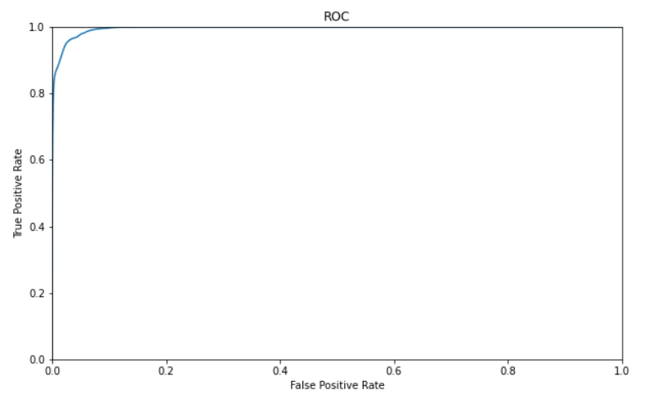
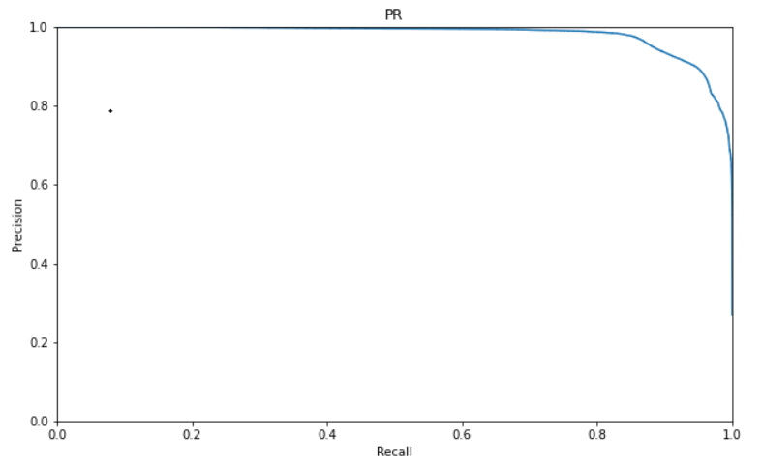
Previous Result (1 million)
Data: 1 million records
Num of patients is 20026
Num of features is 25
Num of Alive Records: 53850
Num of Dead Records: 243340
Total Encounters: 297190
AUROC = 0.9953
AUPR = 0.9802
Notes:
AUC = 0.9953470883271867
AUPR = 0.9801770499857151

Slide 10
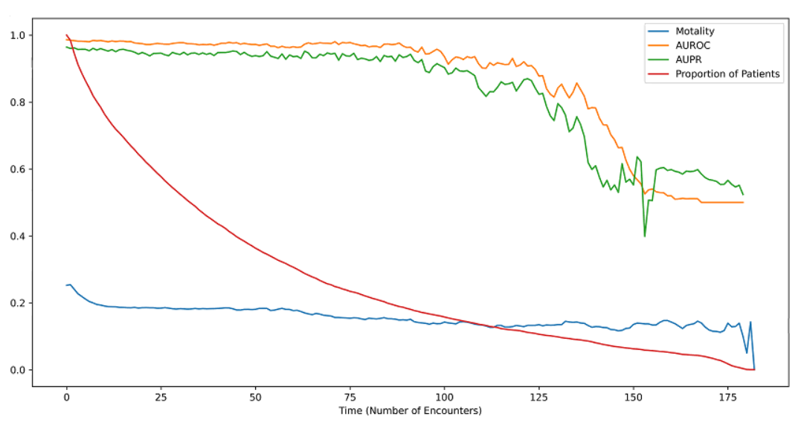
Previous Result (1 million)
The green line is AUPR per time point
The yellow line is AUROC per time point
The red line is the proportion of patients alive per time point
The blue line is 1-year mortality per time point
Notes:
There are less people as time goes by, so the AUPR and AUROC decreases at first and then fluctuate a lot as time goes by.

Slide 11












Current work with linear decoder
Add Causality
Tuning parameters: batch normalization, early stopping, learning rate, hidden dimension, GRU
$$y_{1}$$
$$y_{2}$$
$$y_{3}$$
$$y_{4}$$
$$y_{1}$$
$$y_{2}$$
$$y_{3}$$
$$y_{4}$$
$$h_{1}^{2}$$
$$h_{2}^{2}$$
$$h_{3}^{2}$$
$$h_{4}^{2}$$
$$h_{1}^{2}$$
$$h_{2}^{2}$$
$$h_{3}^{2}$$
$$h_{4}^{2}$$
$$(h_{0}^{2},c_{0}^{2})$$
$$(h_{0}^{2},c_{0}^{2})$$
$$(h_{0}^{1},c_{0}^{1})$$
$$(h_{0}^{1},c_{0}^{1})$$
$$x_{1}$$
$$x_{2}$$
$$x_{3}$$
$$x_{4}$$
$$x_{1}$$
$$x_{2}$$
$$x_{3}$$
$$x_{4}$$
Notes:
Different meanings in different places.

Slide 12
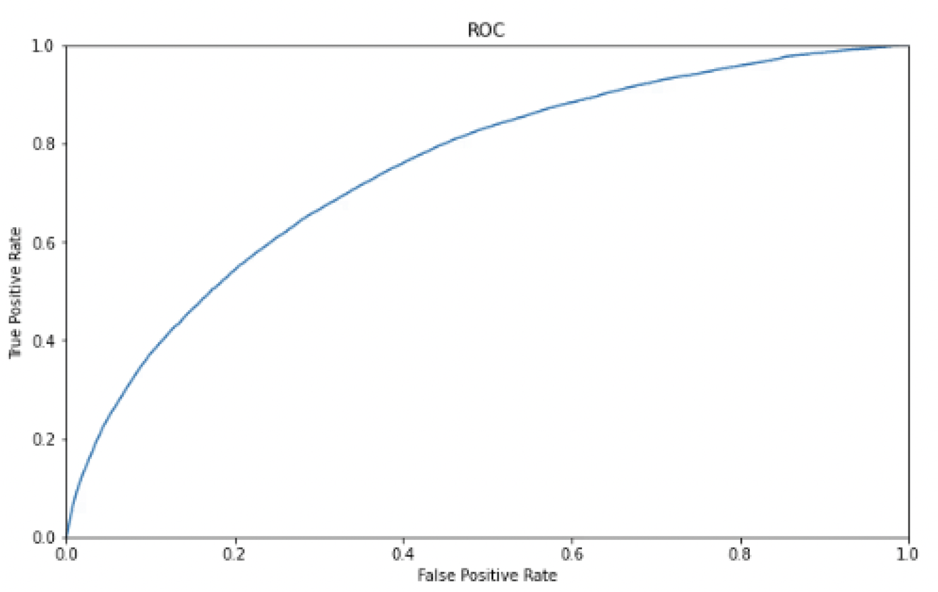
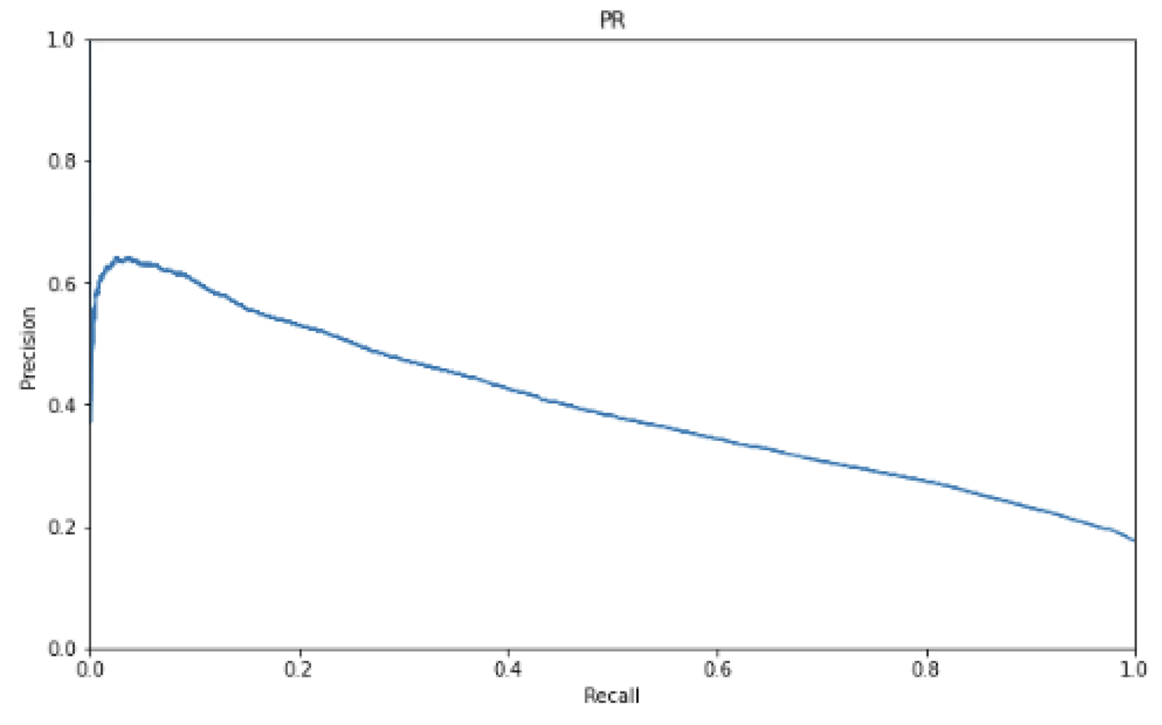
Current Result (1 million)
Data: 1 million records
Hidden_dim = 4
Learning_rate = 0.001
Num of features is 25
Num of Alive Records: 53020
Num of Dead Records: 250159
Total Encounters: 303179
AUROC = 0.7479
AUPR = 0.3969
Notes:
AUC = 0.9953470883271867
AUPR = 0.9801770499857151
good results
can't compare it with the previous results.
have the information up to the point of prediction

Slide 13
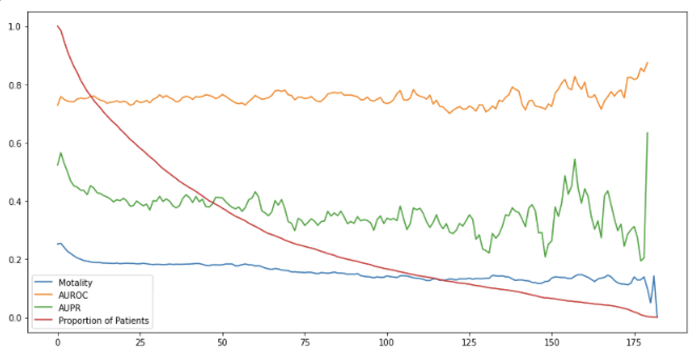
Current Result (1 million)
The green line is AUPR per time point
The yellow line is AUROC per time point
The red line is the proportion of patients alive per time point
The blue line is 1-year mortality per time point
Notes:
There are less people as time goes by, so the AUPR and AUROC decreases at first and then fluctuate a lot as time goes by.

Slide 14
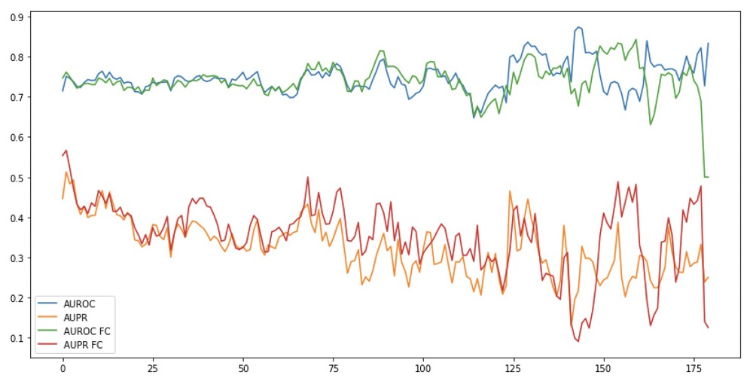
Results with Fully Connected Layers
Fully Connected Layers(Multilabel) allow the model to observe all the information
Notes:
2 class classification
Using past history helps

Slide 15
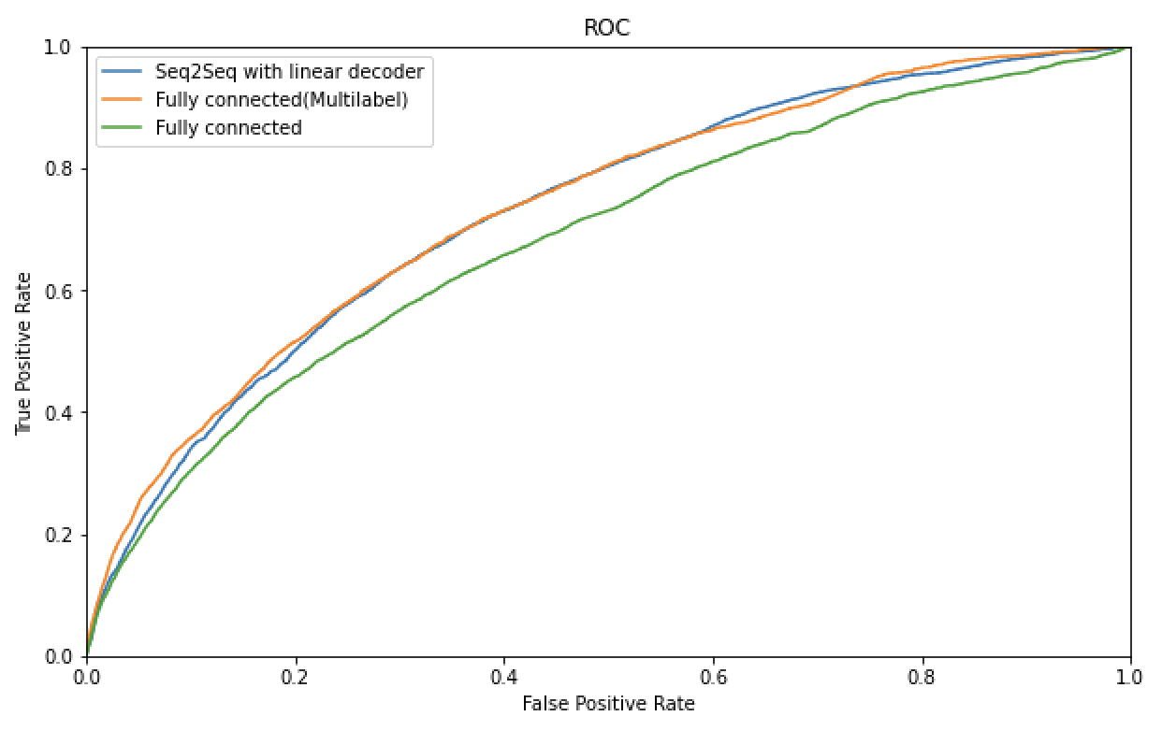
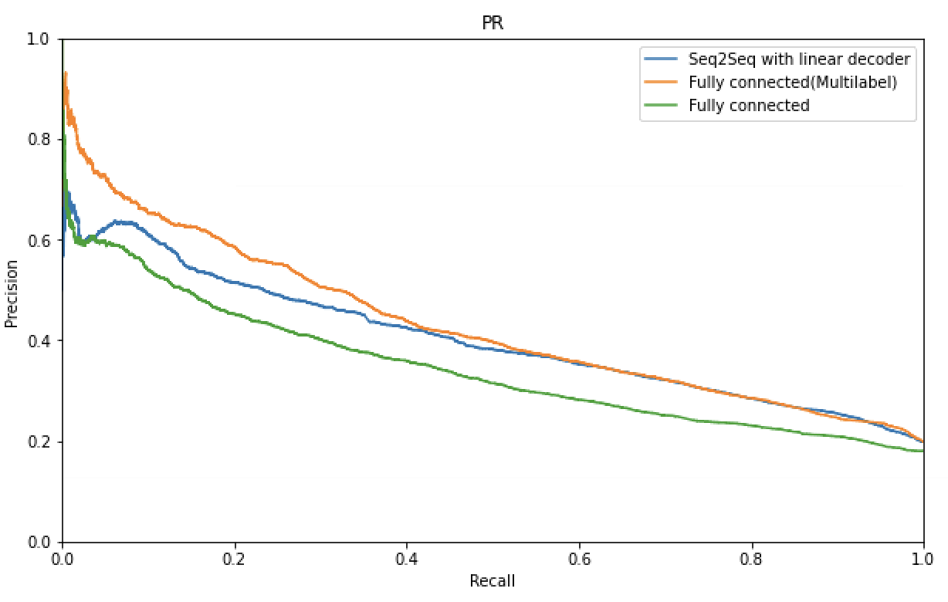
Results with Fully Connected Layers
Fully Connected Layers(Multilabel) allow the model to observe all the information
Fully Connected Layers don’t allow the model to observe all the information
Notes:
2 class classification
Using past history helps

Slide 16
Future work
Try to improve model performance
5-year mortality and n-year mortality
Try to use other architectures
Notes:
Add more bullet points

Slide 17
Thank you!
Any questions?

Slide 18












Future work
$$y_{1}$$
$$y_{2}$$
$$y_{3}$$
$$y_{4}$$
$$y_{1}$$
$$y_{2}$$
$$y_{3}$$
$$y_{4}$$
$$h_{1}^{2}$$
$$h_{2}^{2}$$
$$h_{3}^{2}$$
$$h_{4}^{2}$$
$$h_{1}^{2}$$
$$h_{2}^{2}$$
$$h_{3}^{2}$$
$$h_{4}^{2}$$
$$(h_{0}^{2},c_{0}^{2})$$
$$(h_{0}^{2},c_{0}^{2})$$
$$(h_{0}^{1},c_{0}^{1})$$
$$(h_{0}^{1},c_{0}^{1})$$
$$x_{1}$$
$$x_{2}$$
$$x_{3}$$
$$x_{4}$$
$$x_{1}$$
$$x_{2}$$
$$x_{3}$$
$$x_{4}$$

Slide 19
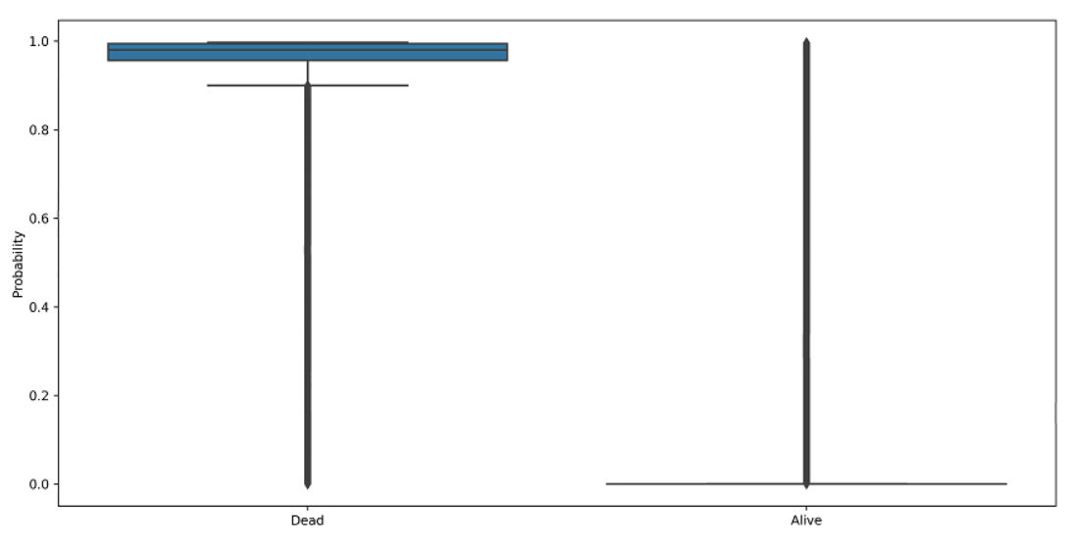
Current Result (1 million)

Slide 20
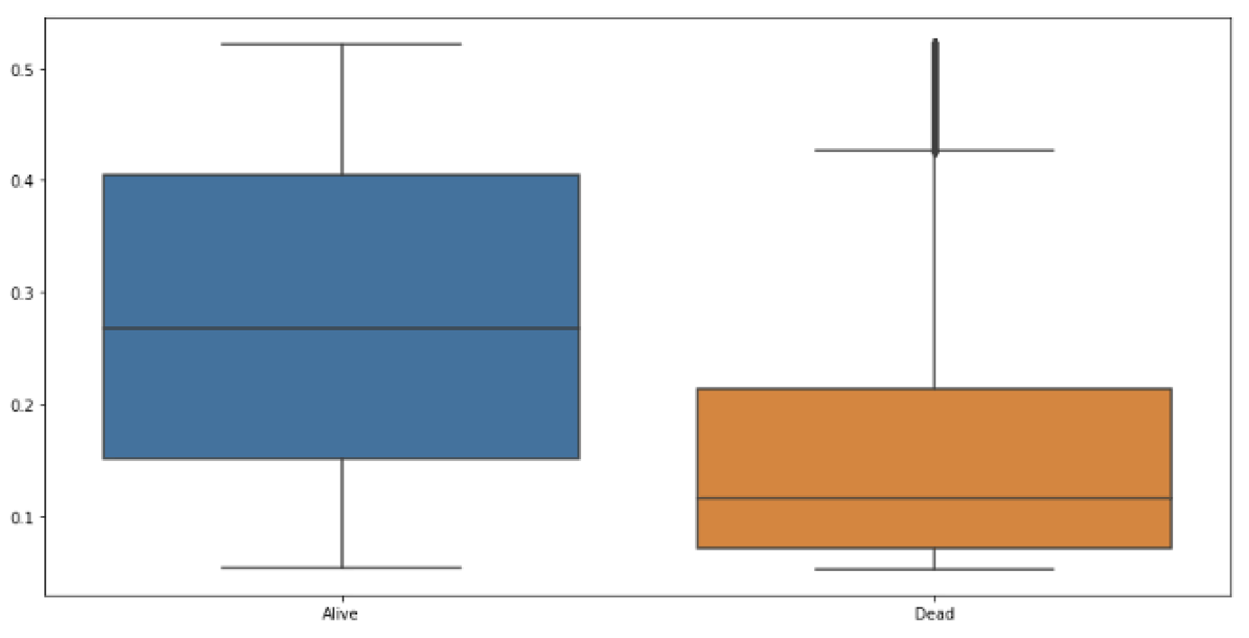
Current Result (1 million)

Slide 21
Seq2Seq Model with LSTM encoder and decoder
$$y_{1}$$
$$y_{2}$$
$$y_{3}$$
$$y_{4}$$
$$(h_{1}^{2},c_{1}^{2})$$
$$(h_{2}^{2},c_{2}^{2})$$
$$(h_{3}^{2},c_{3}^{2})$$
$$(h_{4}^{2},c_{4}^{2})$$
$$(s_{1}^{2},c_{1}^{2})$$
$$(s_{2}^{2},c_{2}^{2})$$
$$(s_{3}^{2},c_{3}^{2})$$
$$(s_{4}^{2},c_{4}^{2})$$
$$(h_{0}^{2},c_{0}^{2})$$
$$z^{2}$$
Encoder
Decoder
$$(h_{0}^{1},c_{0}^{1})$$
$$z^{1}$$
$$x_{1}$$
$$x_{2}$$
$$x_{3}$$
$$x_{4}$$
$$x_{1}$$
$$x_{2}$$
$$x_{3}$$
$$x_{4}$$

